Slide 1
Pride of Baghdad
Characters and Communities

Slide 2
What’s the story about?
Notes:
This story tells of the survival of a pride of lions as they are liberated from a zoo during the 2003 American bombing of Baghdad. The book questions the nature of occupation and the price of freedom. The lions can be seen to represent the decline of Iraqi society after being freed from Hussein’s Ba’ath Party. They are a group of characters who want to do the right thing, but have no idea what that is. The destruction of the zoo and the short-lived freedom of the lions can be seen to represent the decline of Iraqi society after being freed from the Ba’ath party by the US invasion. The use of animals is interesting in Pride of Baghdad. They assume no human features, but they think and act like humans in many ways. They are tragic characters, softening and heightening the emotional impact of the story. They have a somewhat perceived innocence here coming from the zoo, that allows them to elicit a certain level of sympathy from the reader.

Slide 3
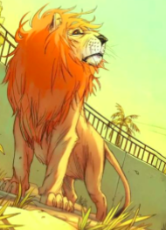
Zill
How does his view towards his captors and his role with the family change?
Notes:
Zill represents an Iraqi citizen that can see both sides. He is a benevolent opportunist who’s willing to live under any kind of keeper so long as his family is fed. But, he also comes to value freedom when he remembers the beauty of the horizon and is convinced not to eat the keeper. However, he is still the oldest male in the pride and tires to protect his family. Also of note, like the Kurdish people in the region, he’s often stuck between two bickering sides.

Slide 4
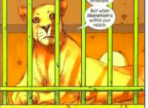
Noor
Does she manage to maintain her fiery spirit throughout their ordeal?
Notes:
Noor is a reform-minded young lioness who wants to earn freedom from her cage rather than be released by some outside force of nature. Noor is meant to represent a Shia Iraqi who was against the rule of Sadaam Hussein. She’s constantly at odds with Safa, who represents a Sunni.

Slide 5
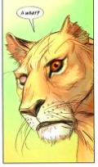
Safa
How will she come out of the conflict?
Notes:
Safa is the older female lion who vividly recalls the dangers of the wild and would happily trade a little freedom for security. You can recognize her by the scarred eye and torn ear. She’s representative of a Sunni Iraqi—remember that that group were in support of Sadaam even if it meant relinquishing freedoms.

Slide 6
Ali
Will he still retain some innocence during the invasion?
Notes:
Ali is the young cub who has never experienced life outside of the zoo. He is a symbol of the future of Iraq and the rising younger generation.

Slide 7
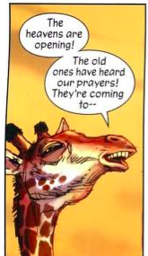
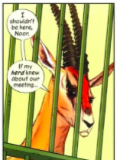
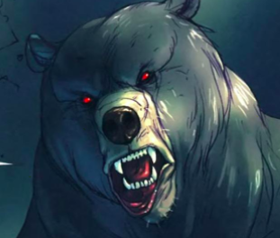
Notes:
In the Zoo, there is a particular social system with different species akin to different cultures and races—we see the different political parties, looters, an evil dictator, maybe even religious extremists. Each wants to protect their own and better themselves. In a way, the microcosm of the zoo parallels our own cultural “zoo”.

Slide 8
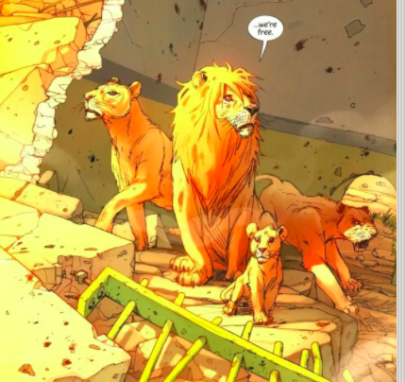
Showing their characteristics
How are the different characteristics of each lion shown through their stances here after the zoo’s cages have been blown up?
As you continue to read, think about how these family “portraits” are drawn at different stages of the story. Do their stances remain the same? Or do they change?
Notes:
In this panel, notice how Zill is still the biggest lion at the center of the frame. He stands tall amongst the pride. Noor, on the left, has an elevated head and raised paw, ready to take on whatever comes her way. Safa, on the right, is in fear and shows a defensive stance. We know that this is in line with her character and past experiences of rape. Finally, Ali is at the front, sitting peacefully. He gazes outwardly with interest in his surroundings. He doesn’t appear frightened at all, but perhaps curious. This particular panel sets up the lion’s character traits in visual format.

