Slide 1
Provocative Panels
Maus II: And Here My Troubles Began

Slide 2
“I love you too”
In this panel sequence here, Artie is on the phone with his father after he had claimed to have a heart attack. We don’t hear Vladek’s voice, so we have to infer what he is saying to Artie. In the fourth panel here, Artie seems to uncomfortably respond to his father saying that he loves him, as indicated by the ellipsis (a pause) and “um.” He has trouble saying this back, or is at least hesitant.
Question: How is this reminiscent of the passage in Prisoner on the Hell Planet when Artie recalls not being able to tell his mom that he loved her?? Is he trying to make up for that fact now with his dad?

Slide 3
Dark Times
I find these two panels very haunting. We see the smoke from the chimneys burning in the background sky, wafting towards the new prisoners at the camp. In the next panel which takes us back to the present day, Artie and Vladek’s faces are all in black. We can’t see their emotions and ”read” their faces. The text doesn’t give much but factual information.
Question: Why does Spiegelman use this particular device when drawing them? What’s the significance in showing their faces all in black?

Slide 4
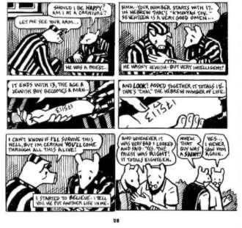
Religion and Survival
Here’s a powerful scene with Vladek and a priest in Auschwitz. The priest is a Pole and reads Vladek’s number tattoo as a sign that he will survive the camps. Artie goes so far as to call the man “a saint.”
Question: In what ways is this passage focused on religion as a survival mechanism? What about hope? Is it just a coincidence?

Slide 5
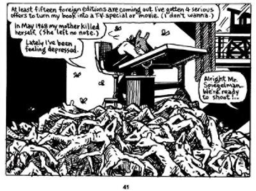
Depression
We haven’t talked much about depression, but we’ve looked at a few panels with Anja, Artie’s mom.
This is one of the most famous panels in the graphic novel and combines the past, present, and future in a way in which we cannot ignore.
Question: What do you make of the placement of the bodies below Art and the watch tower outside of his window? Why is he wearing a mouse mask now? Why is this so poignant when addressing the topic of depression?

Slide 6
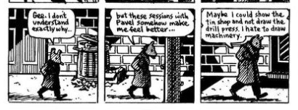
Artie’s Figurative Transformation
Question: Why draw himself this way? Why doesn’t he feel like an adult? What makes him feel small and incapable? What seems to help? What’s the irony here?
Boy to Man…
Man to Boy…

Slide 7
Reliable Witness?
Throughout Maus, we’ve been getting first-hand accounts of the horrors of the war, the racial conflicts, and now the experiences in the camps. We’ve relied on Vladek’s memory to inform Art and for Art to relay those stories through the graphic novel. Here, Vladek uses his memory while Artie draws on research from another “source.”
Question: How reliable are Vladek’s stories? Are his memories of the time still intact? As a reader of the graphic novel, do you see this more of a historical account from a witness or one man’s (Artie or Vladek?) interpretation of what occurred?

Slide 8
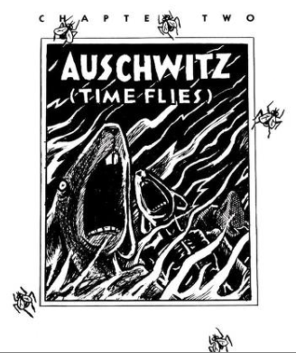
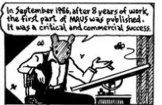
Pests everywhere!
In this chapter particularly, we see the use of flies to represent horrible events that pester the characters’ lives. There are other “pests” throughout Maus, of course. We looked at a few like rats in the bunkers. And, the cat and mouse metaphor is at the center of the story.
Question: What other pest metaphors have you discovered in the readings both visually and in the text?

